Slide 1
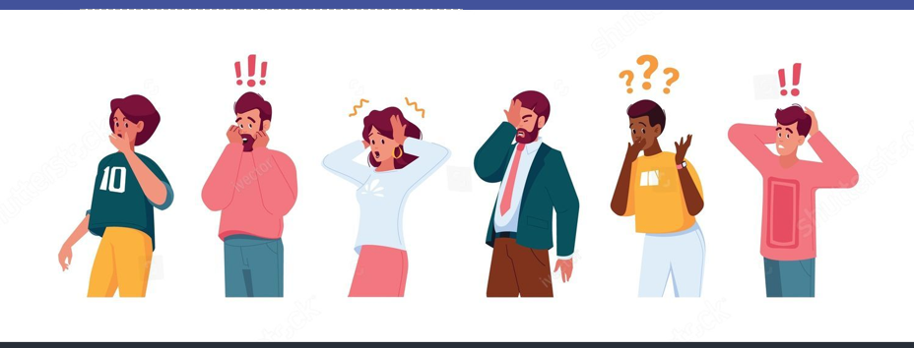

Slide 2

Encouraging Mature Responses to Difficult Situations
RYCNC Lunch & Learn Series 2025

Slide 3

Your Focus Matters
4 Reasons Why

Slide 4
Your Focus Matters
Listening Comes First, Talk Follows.
  Tell them their involvement is essential to solving the problem.
  We all need to be heard.
Understand the Facts, Then Address the Problem.
  There may be facts or perceptions you don’t know yet.
1. Focus on the Issue, not the Person
  Are you quick to blame?
  Is this you? “If you’re not for me, you’re against me.”

Slide 5
Your Focus Matters
2. Don’t Take Things Personally
Do you get defensive or angry easily?
Do you apologize needlessly?
Do you obsess over recent conversations?
It’s normal to care about what others think about us, but not to the point where it hinders us.
Ideas:
  Stop worrying about what others think about you.
  Give yourself credit for your strengths.
  Journal your thoughts so you can see patterns in your reactions

Slide 6
Your Focus Matters
3. Choose Your Battles
Every battle has a cost to it.
How important is this to you? Will it matter next month? Next year?
What is the payoff if you win? But what if you lose? Do the costs outweigh the benefits?

Slide 7
Your Focus Matters
4. Focus on What you can Control
“Incredible change happens in your life when you decide to take control of what you do have power over instead of craving control over what you don’t.” – Steve Maraboli
Get real with yourself.
Get rid of “crutch” words like “but” and “what if”.
  “What if I can’t keep everyone happy?”
Face your fears. Don’t allow anxiety to paralyze you or force a confrontation.

Slide 8

Your Skills Matter
5 Reasons Why

Slide 9
1. Set Boundaries Without Being Mean
Boundaries aren’t meant to control others but rather make sure your needs are met so that you can be there for both yourself and others in a more effective way.
Your Skills Matter
Recognize your worth! It’s OK to prioritize yourself without feeling guilty.
Use “I” statements to keep the focus on yourself and your needs.
  “I need a heads-up before you stop by.”
  Vs
  “You need to text me before you stop by.”
Keep things as simple as possible.
No need to apologize or over-explain.

Slide 10
2. Practice Empathy
Do you make snap judgments?
Your Skills Matter
Try to understand the feelings and perspectives of others.
Be curious about different experiences.
Pay attention to body language.
Ask questions instead of making assumptions.

Slide 11
3. Communicate Clearly
Can I come to the point?
Am I credible?
Your Skills Matter
Prepare first.
Tape yourself
Speak clearly
Use concise and simple language.
Keep your goal in mind.
Ask simple questions.

Slide 12
4. Avoid Confrontation
Take your time
Think it through
Your Skills Matter
Listen and don’t interrupt.
Be open to new and different ideas.
Apologize if you have hurt someone’s feelings by what you have said.
Research the issue. Understand where a point of view has come from and how it affects the people involved.

Slide 13
5. Seek Solutions not Arguments
LOSE/LOSE
  Each person sticks to their intractable position.
  The “I’m right, and you’re wrong” stance doesn’t change, and both people leave without a satisfactory outcome.
WIN/LOSE
  Results in only one person feeling that the outcome is positive.
  Winner feels good, and loser feels imposed upon.
WIN/WIN
  Both people feel they have won.
  Both people feel satisfied with the outcome and the solution
  Both people embrace the reality that the other person has won also.
Your Skills Matter

Slide 14

Self-Care Matters
3 Reasons Why

Slide 15
1. Take Care of Yourself
Gather your relaxation techniques
Breathing, shoulder shrug, positive self-talk
Know your conflict style.
      Are you the exploder?
    Do you avoid conflict? Hide in silence?
    Do you try to please everyone?
Forgive yourself, even laugh at yourself.
Is fear nagging at your gut?
Do you go into full panic mode?

Slide 16
2. Practice Self-Reflection
It is important to both be in the present moment and look to the future. It is also important to stop living in the past.
Many people just go blindly throughout life, not thinking about what they are doing.
They wonder why all these bad things happen to them, and it may be in fact, because of their actions.
Above all, be honest with yourself.
It is a conscious examination of our experiences.
We can leverage our talents and work towards personal growth.

Slide 17
3. Know When to Walk Away
Have an exit point where you say, “Ok, that’s it. Time to cut my losses and move on.”
Success comes not from winning every battle, but in learning to let go when it’s time to do so.
How?
Acknowledge how you are feeling.
Understand why you are feeling this way.
Identify new ways to move forward.
What conflict is taking up your energy?
Are your battles distracting you from what’s really important?
How important is your peace of mind?

Slide 18
Resources Used
https://www.bolde.com/14-ways-an-emotionally-mature-person-handles-difficult-people/Technology integration
  Explore emerging technologies for potential integration into our operations.
https://www.aconsciousrethink.com/49386/emotionally-mature-people-respond-to-disrespect-with-these-9-dignified-strategies/
https://www.ourmental.health/intelligence/12-emotionally-intelligent-responses-to-difficult-situations

Slide 19

Thank You!
Next: Circle Time

